Slide 1
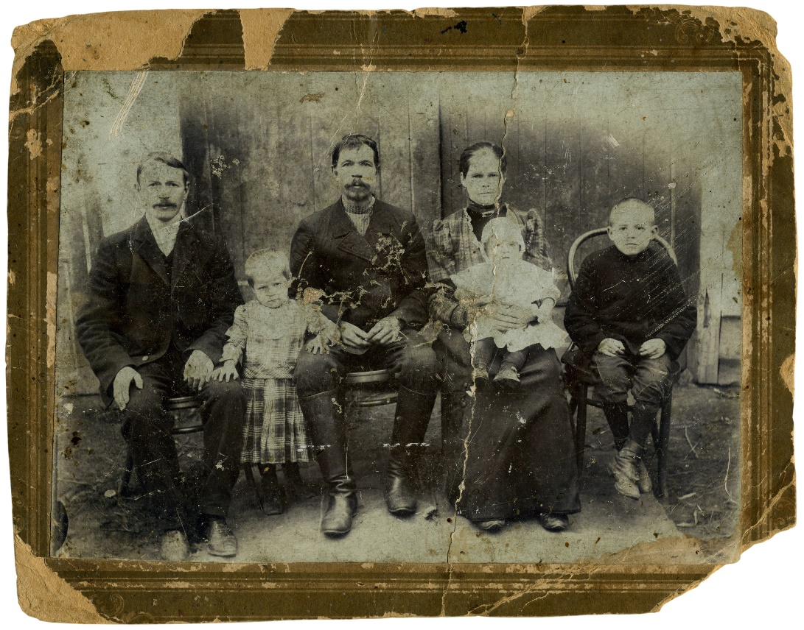
Images
Image Formats
Where’s Buddy?
Resizing Images
Images as Links

Slide 2
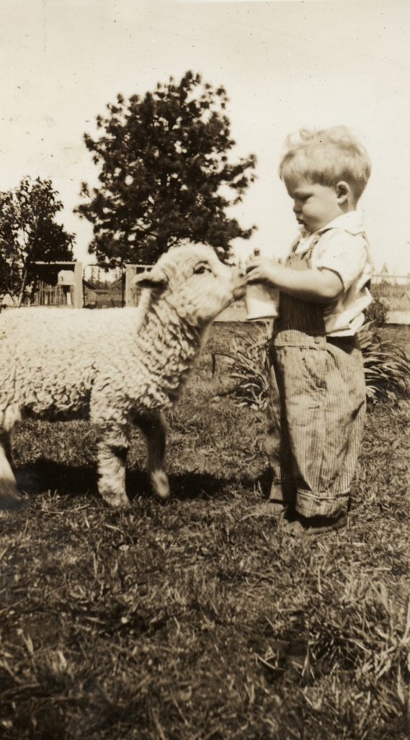
See Also
https://www.sitepoint.com/gif-jpg-png-whats-difference/
https://www.w3schools.com/tags/tag_img.asp
http://stackoverflow.com/questions/419584/what-is-the-difference-between-jpg-jpeg-png-bmp-gif-tiff-i

Slide 3

In the Book
Chapter 5:
Adding Images to Your Pages

Slide 4


Image Formats
Extension | Format | Good For | Compression | Transparency
JPG | Joint Photographic Experts Group | Photos | Lossy | No
PNG | Portable Network Graphics | Clip art, drawings | Lossless | Yes (with alpha)
GIF | Graphics Interchange Format | Clip art, drawings | Lossless | Yes (and animation)
BMP | Bitmap | Nothing! | Lossless | No

Slide 5


Remember <img>
<img src="sleep.png">
<img src="sleep.png" alt="Intro">
<img src="sleep.png" alt="Intro" width="500">
<img src="sleep.png" alt="Intro" width="500" height="1000">
500
600
1000
500
450
375

Slide 6


Where’s Buddy?
Buddy has been around the world! Make a photo web site of his travels!
Not really a journal
More of a photo album

Slide 7
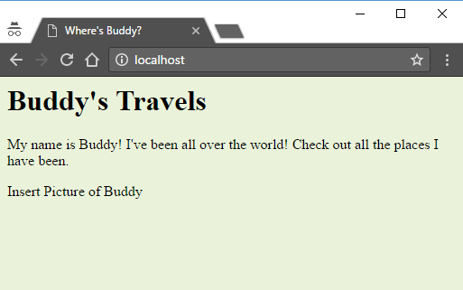
First Page
index.html
<html>
<head>
<title>Where's Buddy?</title>
<style type="text/css">
body {
background-color: #eaf3da;
}
</style>
</head>
<body>
<h1>Buddy's Travels</h1>
<p>My name is Buddy! I've been all over the world!
Check out all the places I have been.</p>
<p>Insert Picture of Buddy</p>
</body>
</html>

Slide 8


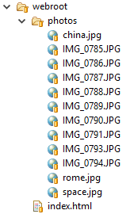
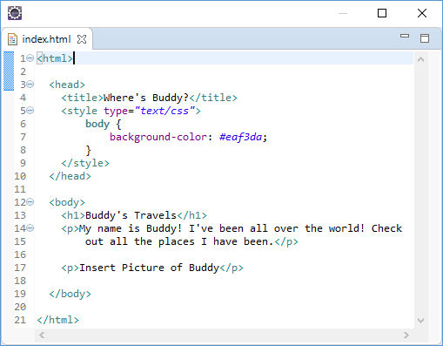
Structure

Slide 9
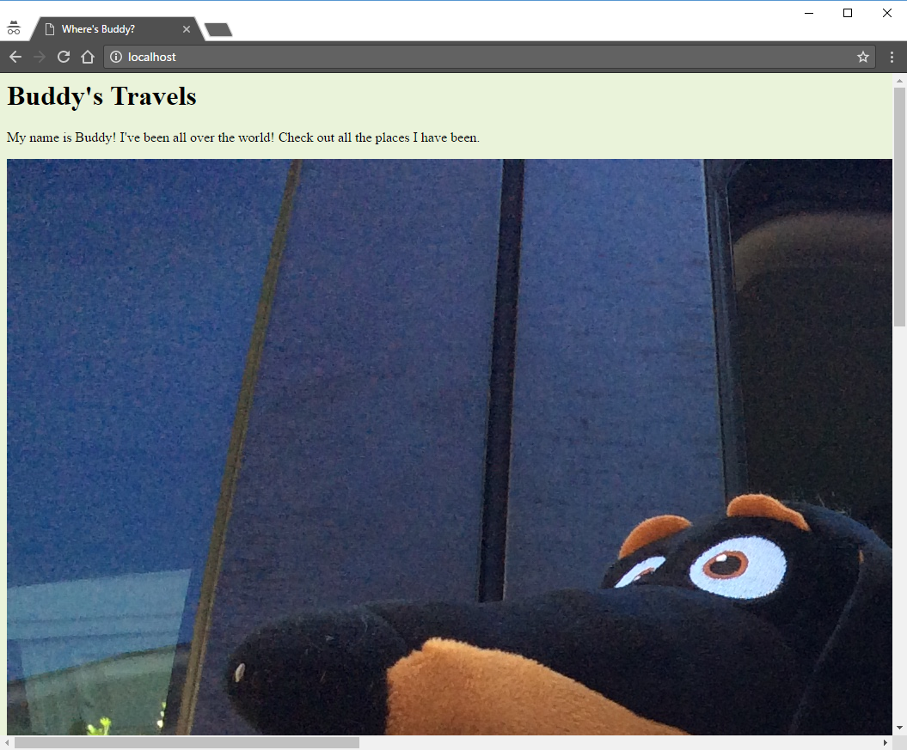

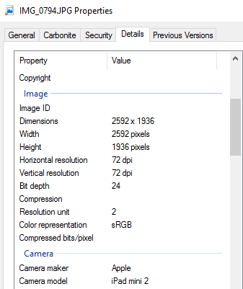
Big Buddy
<h1>Buddy's Travels</h1>
<p>My name is Buddy! I've been all over the
world! Check out all the places I have
been.</p>
<img src="photos/IMG_0794.JPG">

Slide 10
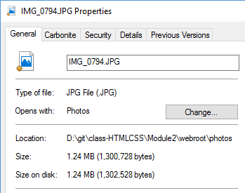
Resizing Images
We could use the width/height attribute
The web server must still download the large file
Better to use a program to resize the image
Make several sizes for different viewing devices
(more on that later)

Slide 11
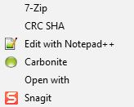

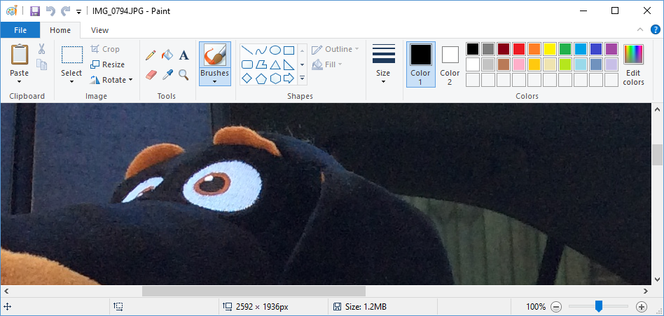
Microsoft Paint

Slide 12
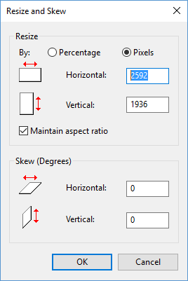
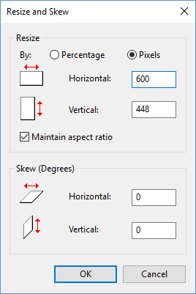

Microsoft Paint

Slide 13
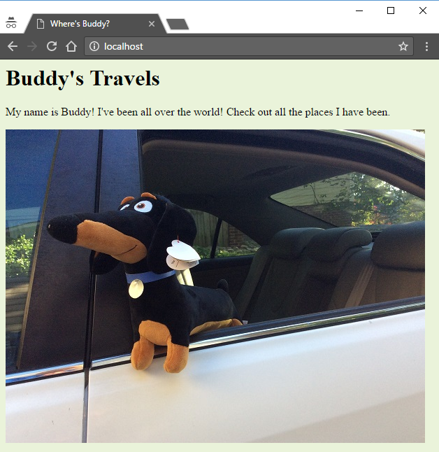
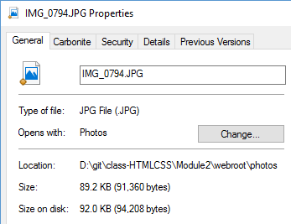
Medium Buddy

Slide 14
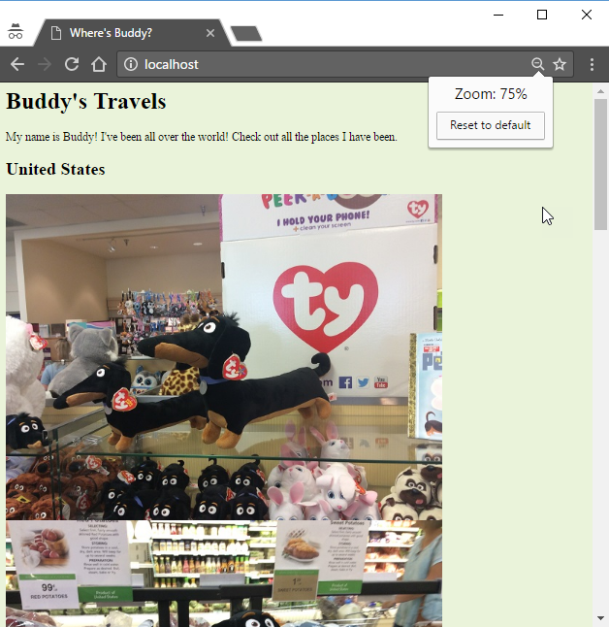
Buddy’s Page
index.html
<h1>Buddy's Travels</h1>
<p>My name is Buddy! I've been all over the world!
Check out all the places I have been.</p>
<h2>United States</h2>
<img src="photos/IMG_0785.JPG">
<img src="photos/IMG_0786.JPG">
<img src="photos/IMG_0793.JPG">
<h2>Europe</h2>
<img src="photos/IMG_0790.JPG">
<img src="photos/IMG_0789.JPG">
<img src="photos/IMG_0788.JPG">
The page is still very long
Not easy to navigate
We need thumbnails

Slide 15
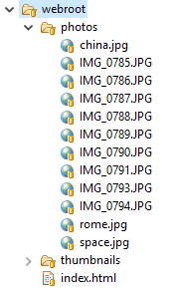
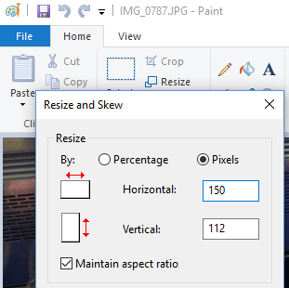
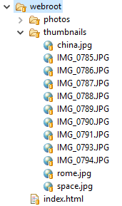
Making Thumbnails
Copy “photos” to “thumbnails”
Resize the thumbnails photos

Slide 16
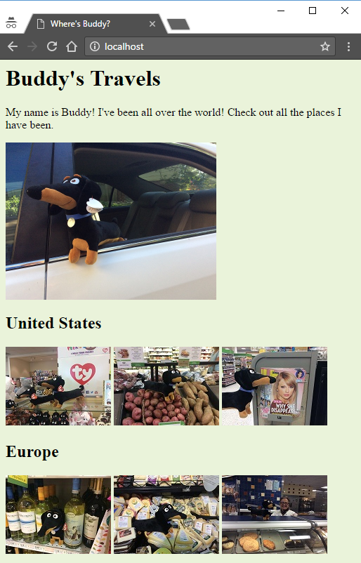
Using the Thumbnails
index.html
<h1>Buddy's Travels</h1>
<p>My name is Buddy! I've been all over the world!
Check out all the places I have been.</p>
<img src="photos/IMG_0794.JPG" width="300">
<h2>United States</h2>
<img src="thumbnails/IMG_0785.JPG">
<img src="thumbnails/IMG_0786.JPG">
<img src="thumbnails/IMG_0793.JPG">
<h2>Europe</h2>
<img src="thumbnails/IMG_0790.JPG">
<img src="thumbnails/IMG_0789.JPG">
<img src="thumbnails/IMG_0788.JPG">
The <img> is an inline element
The big images wrapped

Slide 17
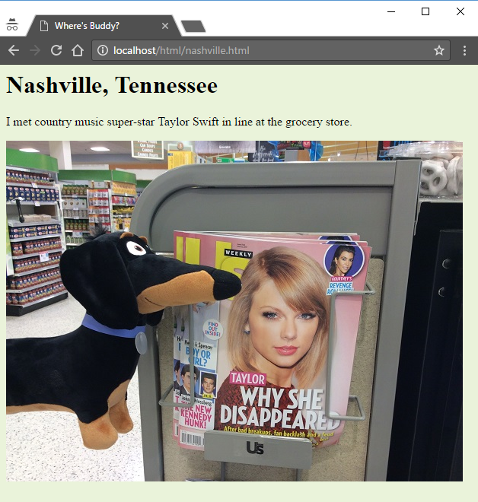
Describe Each Photo
nashville.html
<html>
<head>
<title>Where's Buddy?</title>
<style type="text/css">
body {
background-color: #eaf3da;
}
</style>
</head>
<body>
<h1>Nashville, Tennessee</h1>
<p>I met country music super-star Taylor Swift
in line at the grocery store.</p>
<img src="../photos/IMG_0793.JPG">
</body>
</html>
Separate HTML page for each photo
Use the full-size photos here

Slide 18
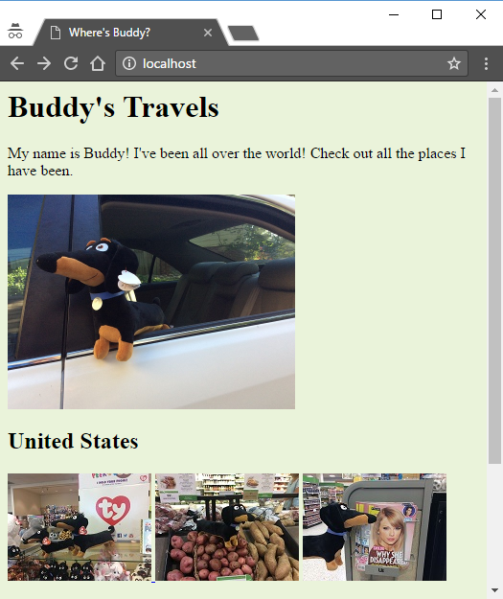
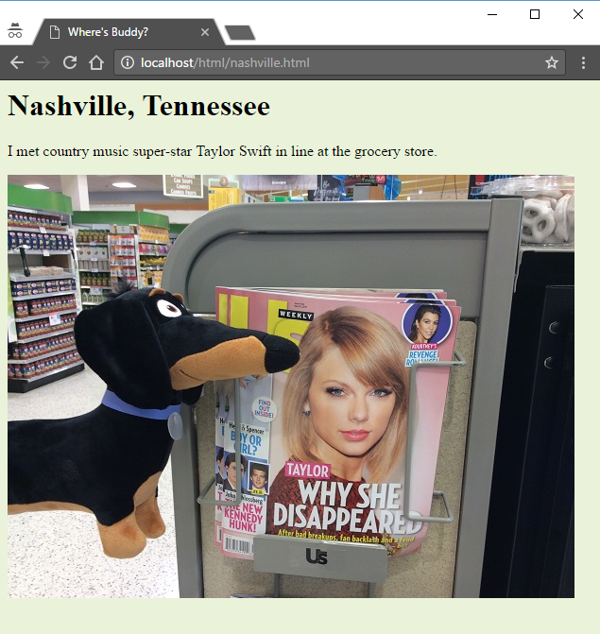
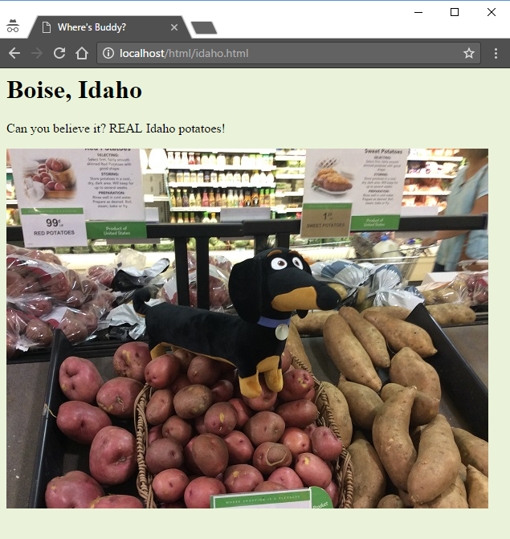
Images as Links
index.html
<h1>Buddy's Travels</h1>
<p>My name is Buddy! I've been all over the world! Check
out all the places I have been.</p>
<img src="photos/IMG_0794.JPG" width="300">
<h2>United States</h2>
<a href="html/huntsville.html">
<img src="thumbnails/IMG_0785.JPG">
</a>
<a href="html/idaho.html"><img src="thumbnails/IMG_0786.JPG"></a>
<a href="html/nashville.html"><img src="thumbnails/IMG_0793.JPG"></a>
<h2>Europe</h2>
<a href="html/rome.html"><img src="thumbnails/IMG_0790.JPG"></a>
<a href="html/france.html"><img src="thumbnails/IMG_0789.JPG"></a>
<a href="html/venice.html"><img src="thumbnails/IMG_0788.JPG"></a>

Slide 19
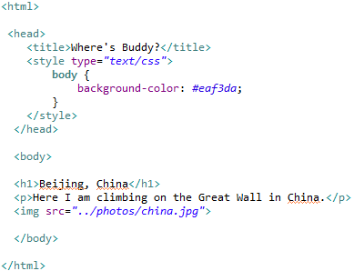
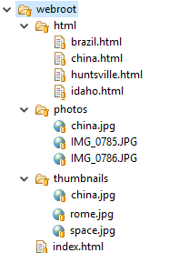

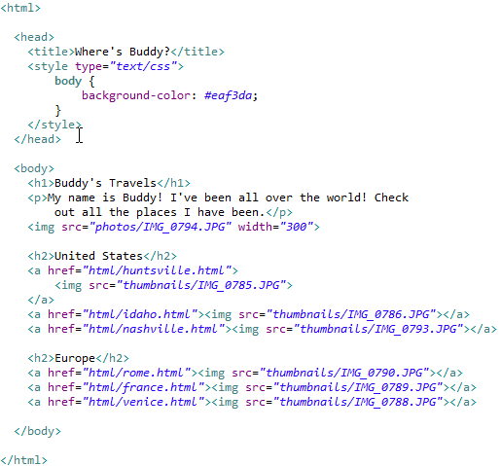
New Structure

Slide 20

Tinkering
How would you add a page for each area (like the U.S.) with a page of thumbnails for all spots in that area?
What thumbnails would you use for the new major-area grouping?

